Slide 1


EV VEHICLE / CHARGING DEMAND PREDICTION
__________________________________________
Name :- Rahul Jitendra Shirsat.
AICTE Student ID:
STU6862a0b3d8e4d1751294131
AICTE Internship ID: INTERNSHIP_1748923002683e727a876ea

Slide 2

Learning Objectives
Understand EV Adoption Trends
Analyze historical electric vehicle registration data at the county level.
Identify seasonal, geographic, and socio-economic patterns influencing EV growth.
Develop Predictive Models
Apply machine learning and time-series forecasting techniques to predict EV adoption.
Engineer advanced features (lag values, rolling averages, growth slopes) for improved accuracy.
Implement Data-Driven Forecasting
Build a scalable forecasting framework capable of producing 36-month predictions.
Validate model performance using real-world EV registration trends.
GOAL
Source :
www.freepik.com/

Slide 3
Learning Objectives
Visualize Forecasts for Stakeholders
Design an interactive Streamlit dashboard to visualize historical and forecasted data.
Enable county-wise and multi-county comparisons for better decision-making.
Support Sustainable Infrastructure Planning
Provide insights to policy-makers, utility companies, and private investors for charging station placement.
Contribute to the broader goal of accelerating EV adoption and reducing carbon emissions.
GOAL
Source :
www.freepik.com/

Slide 4
Tools and Technology used
Programming Language & Environment
Python 3.10.8 – Core programming language for data processing, model training, and deployment.
Data Processing & Analysis
Pandas – Data manipulation, cleaning, and transformation.
NumPy – Numerical computations and array operations.
SciPy – Statistical and mathematical functions.
Machine Learning & Forecasting
Scikit-learn – Regression modeling, feature engineering, and evaluation.
Statsmodels – Time-series statistical modeling.
TensorFlow – Advanced deep learning capabilities (future scalability).
Data Visualization
Matplotlib – Static plotting for historical vs. forecasted EV trends.
Streamlit Charts – Interactive graphs and dashboard components.

Slide 5
Tools and Technology used
Model Deployment & Application
Streamlit – Deployment of the EV Adoption Forecast web application.
Joblib – Model serialization and loading.
Version Control & Collaboration
GitHub – Code repository, version tracking, and project documentation.
Libraries from requirements.txt
numpy==1.26.4
pandas==1.5.3
scikit-learn==1.6.1
scipy==1.15.2
statsmodels==0.14.4
streamlit==1.44.1
tensorflow==2.19.0

Slide 6
Methodology
Data Collection
Washington State EV Population dataset with county-wise historical records
Data Preprocessing
Cleaned, formatted dates, removed duplicates, encoded counties.
Feature Engineering
Created lag features, rolling averages, % change metrics, and growth slopes.
Model Training
Regression-based forecasting model built with Scikit-learn.
Saved as forecasting_ev_model.pkl for reuse.
Forecasting
Generated 36-month EV adoption predictions per county.
Calculated growth percentages.
Visualization & Deployment
Interactive Streamlit dashboard with single & multi-county trend graphs.

Slide 7
Problem Statement:
The rapid growth of electric vehicle (EV) adoption presents a significant challenge for charging infrastructure planning and energy demand management. Local governments, utility providers, and private investors lack accurate forecasting tools to anticipate future demand.
Without such predictive models, decision-makers risk:
Underestimating demand, leading to charging station shortages and congestion.
Overestimating demand, causing under-utilization and wasted resources.
This project addresses the challenge by analyzing historical EV population data (including county-level adoption trends, vehicle categories, and temporal growth patterns) to predict the number of electric vehicles for the next 3 years.
The goal is to enable data-driven infrastructure planning that supports sustainable transportation growth.

Slide 8
Solution:
AI-Driven EV Demand Prediction Engine –
Leverages machine learning to forecast county-level EV adoption for the next 36 months with high accuracy.
Advanced Feature Engineering –
Incorporates historical trends, lag variables, rolling averages, percentage changes, and growth slopes for robust forecasting.
Dynamic & Interactive Dashboard – Built on Streamlit, enabling users to:
Select any county from Washington State.
View historical + predicted adoption trends in one click.
Compare up to 3 counties side-by-side for strategic insights.

Slide 9
Solution:
Actionable Insights for Stakeholders –
Empowers policy-makers, urban planners, utility providers, and investors to:
Optimize charging station placement.
Anticipate infrastructure needs.
Support sustainable EV ecosystem growth.
Scalable Architecture –
Easily extendable to other states, nations, and additional datasets like energy usage and demographic trends.
GITHUB LINK :- https://github.com/RahulShirsat04/EV_Vehicle_Charging_Demand_Prediction.git

Slide 10
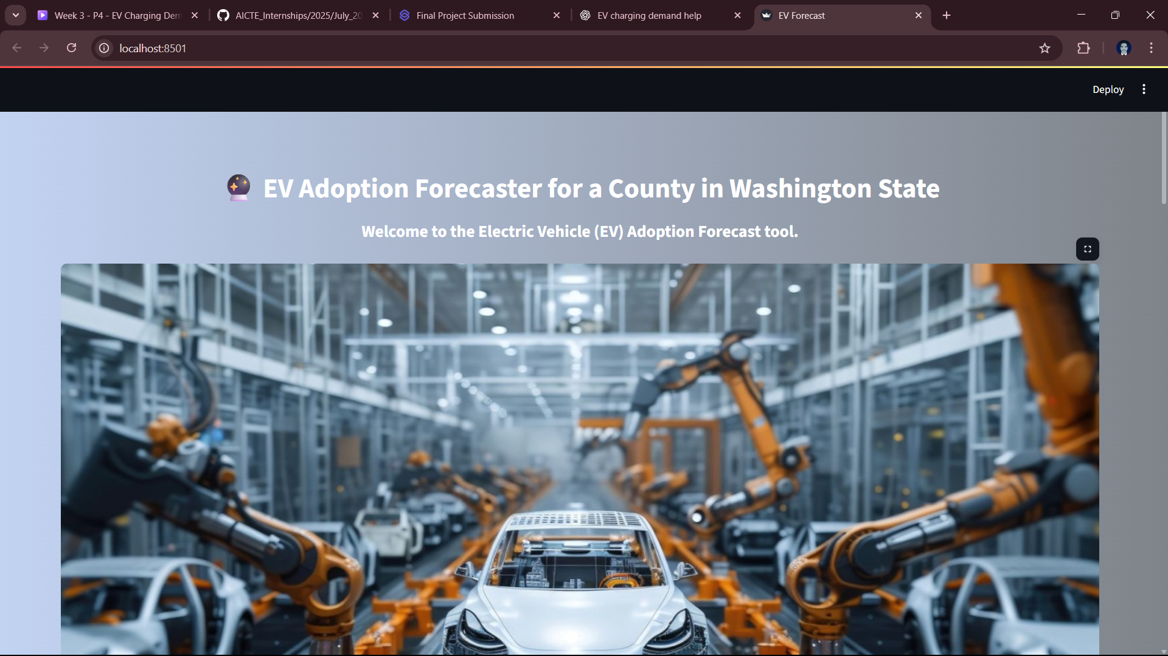
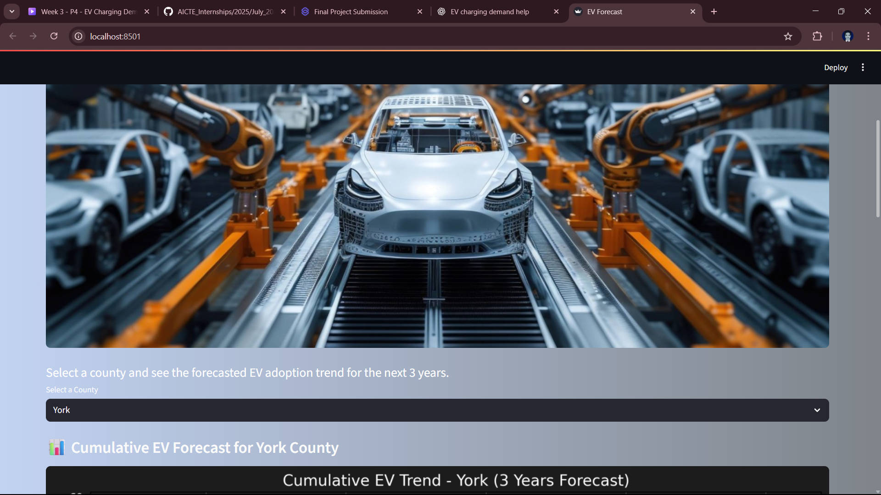
Screenshot of Output:
1
2

Slide 11
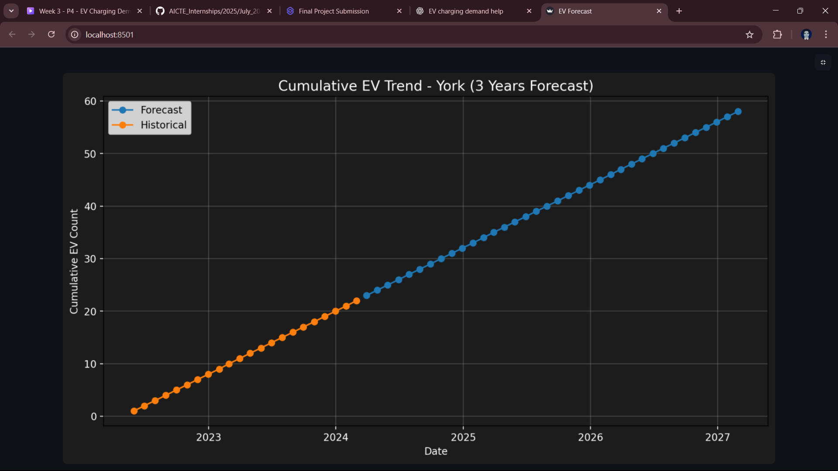
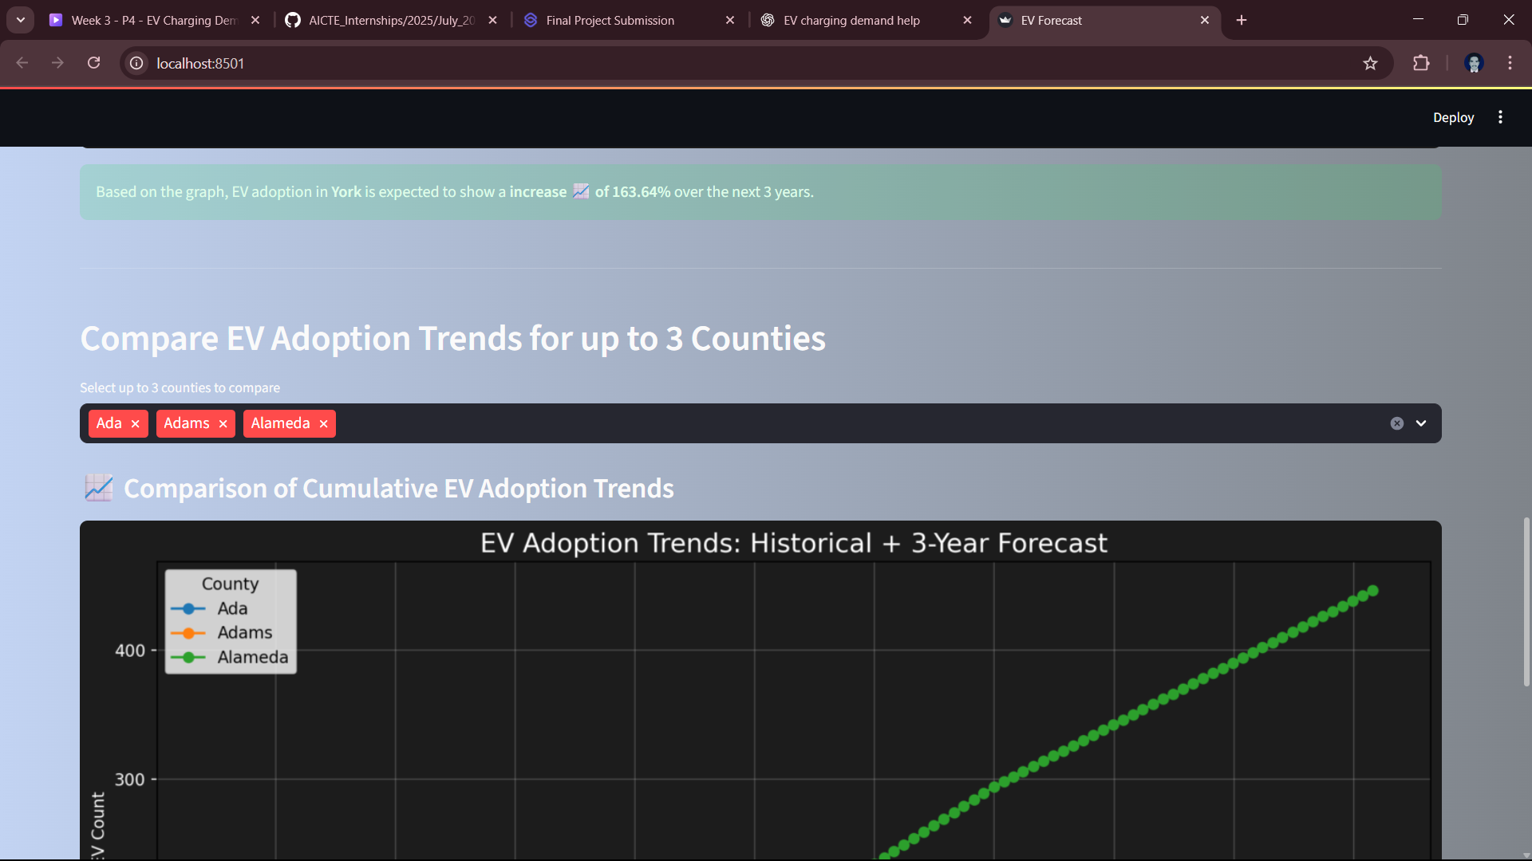
Screenshot of Output:
3
4

Slide 12
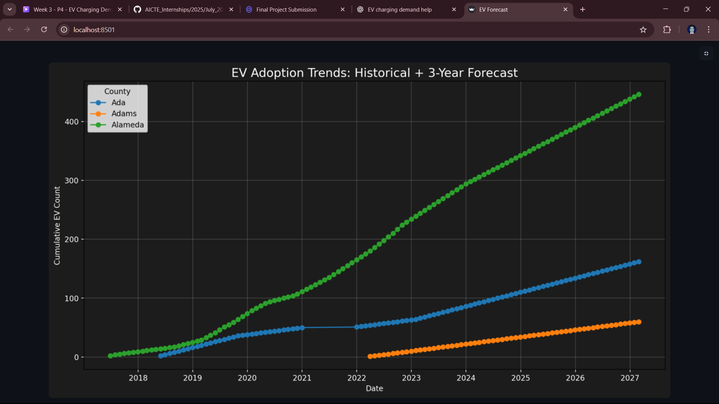
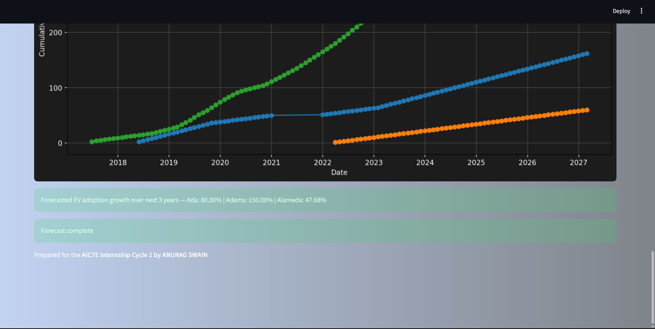
Screenshot of Output:
5
6

Slide 13
Conclusion:
This project is not just a technical implementation — it’s a strategic blueprint for the future of electric mobility.
By merging real-world EV adoption data with cutting-edge AI forecasting, we’ve created a solution that is:
Accurate – Predicting county-level EV growth 36 months ahead with intelligent feature engineering.
Actionable – Delivering insights that directly guide infrastructure investments and policy decisions.
Interactive – Empowering stakeholders with a visually engaging, user-friendly dashboard.
Scalable – Ready to expand to national and global levels, integrating live data streams for real-time predictions.

Slide 14
Conclusion:
Why It Matters:
Every charging station installed in the right place at the right time accelerates EV adoption and reduces carbon emissions.
This isn’t just forecasting numbers — it’s enabling sustainable change, shaping transportation for the next decade.
💡 Final Note: "We are not just predicting the future of electric vehicles — we are engineering it." ⚡🌍

